Slide 1
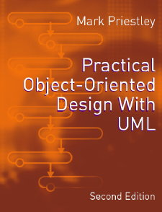
PRACTICAL
OBJECT-ORIENTED
DESIGN WITH UML
2e
Chapter 10:
Statecharts

Slide 2
Specifying Behaviour
Interaction diagrams
  show how object behave in particular interactions
  do not specify all the possible behaviours of objects
Different notation is needed to summarize the overall behaviour of objects
UML defines statecharts for this purpose

Slide 3
State-dependent Behaviour
Objects respond differently to the same stimulus at different times
This is modelled by defining a set of states
  an object can be in one state at any time
  the state it is in determines how it responds to events detected or messages received
  in particular, an event can cause the object to move from one state to another (a transition)

Slide 4
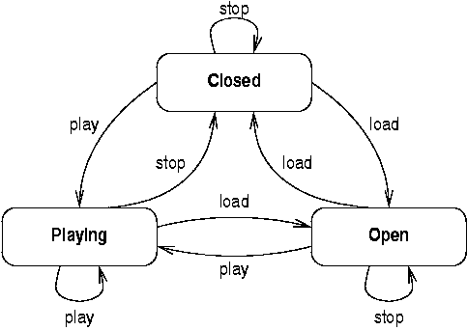
States, Events and Transitions
A simple statechart for a CD player:

Slide 5
Statechart Semantics
A statechart defines the behaviour of instances of a given class
An object is in one active state at a time
Events may be received at any time
An event can trigger a transition
  a transition from the active state will fire if it is labelled with the event just received
The transition leads to the next active state

Slide 6
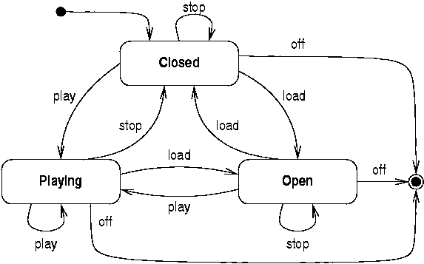
Initial and Final States
Model the creation and destruction of objects

Slide 7
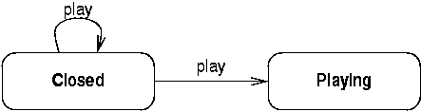
Non-determinism
Sometimes there are two transitions with the same event label leaving a state
Some systems are non-deterministic
  but usually the non-determinism can be removed by adding more information

Slide 8
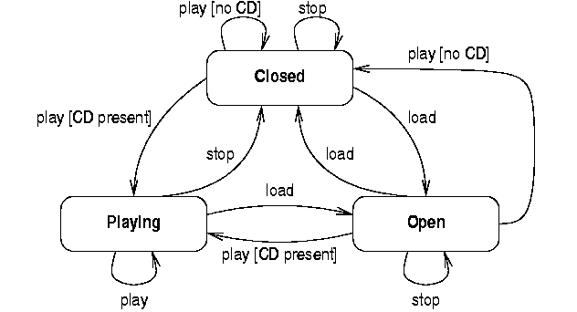
Guard Conditions
Conditions added to events indicate when a transition can fire

Slide 9
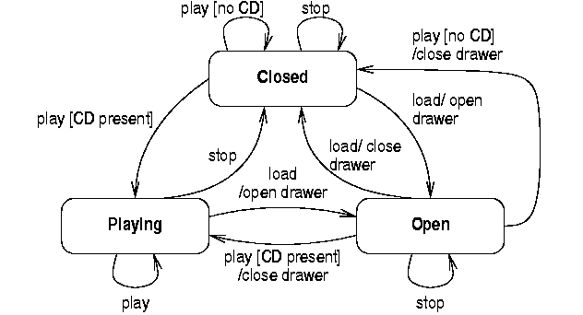
Actions
Actions are performed when a transition fires

Slide 10
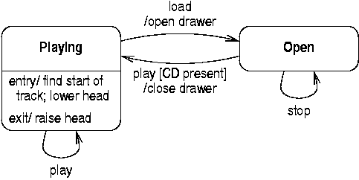
Entry and exit actions
Entry and exit actions are properties of states
  they are performed whenever an object arrives at or leaves the state, respectively

Slide 11
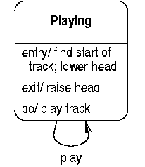
Activities
Activities are also properties of states
  they are performed while the object is in a state
  unlike actions, they can be interrupted by new events

Slide 12
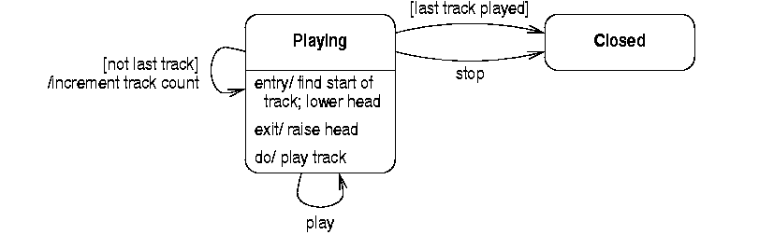
Completion Transitions
If an activity completes uninterrupted it can trigger a completion transaction
  these are transitions without event labels

Slide 13
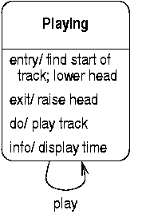
Internal Transitions
Internal transitions do not change state
  and so do not execute entry and exit actions

Slide 14
Composite States
Composite states group together states
  this can simplify a statechart by grouping together states with similar behaviour
An object still has one ‘bottom-level’ active state
  but may be in a composite state as well

Slide 15
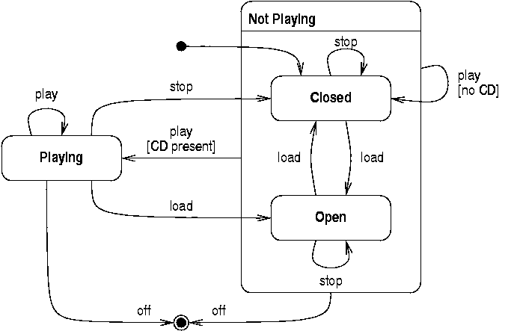
A Composite State

Slide 16
Properties of Composite States
Transitions
  from a composite state apply to all substates
  to a composite state go to the state indicated by a nested initial state
  can cross composite state boundaries
Composite states can have activities and entry and exit actions
A final state in a composite triggers a completion transition from the composite

Slide 17
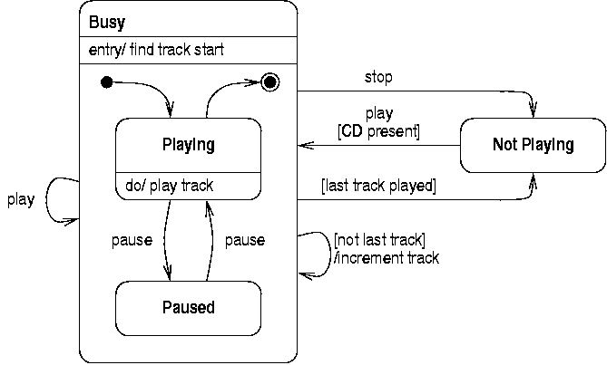
A Complex Composite State

Slide 18
History States
Often an object needs to ‘return to the previous state’
This can be done by defining conditions
  such as ‘[if the last state was Playing]’
Composite states can have a history state
  this ‘remembers’ the last active substate
  a transition to a history state makes that substate active again

Slide 19
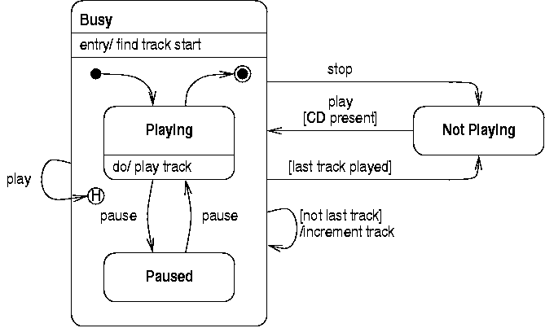
Use of a History State

Slide 20
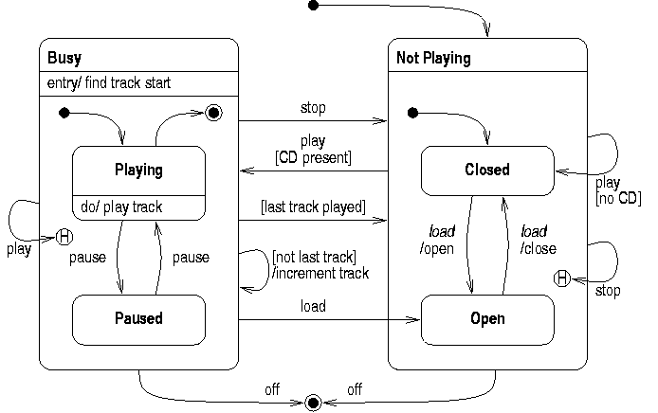
Complete CD Player Statechart

Slide 21
Creating a Statechart
It can be hard to identify all necessary states
Statecharts can be developed incrementally
  consider individual sequences of events received by an object
  these might be specified on interaction diagrams
  start with a statechart for one interaction
  add states as required by additional interactions

Slide 22
Ticket Machine
Consider a ticket machine with two events
  select a ticket type
  enter a coin
Basic interaction is to select a ticket and then enter coins
  model this as a ‘linear’ statechart

Slide 23
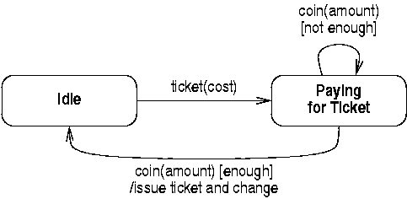
Refining the Statechart
This can be improved by adding ‘loops’
  the number of coins entered will vary: entry will continue until the ticket is paid for
  the whole transaction can be repeated

Slide 24
Adding Another Interaction
The user could enter a coin before selecting a ticket
A ‘coin’ transition from the ‘Idle’ state is needed to handle this event
  this transition can’t go to the ‘Paying for Ticket’ state as the ticket is not yet selected
  so a new state ‘Inserting Coins’ is required
The statechart is thus built up step-by-step

Slide 25
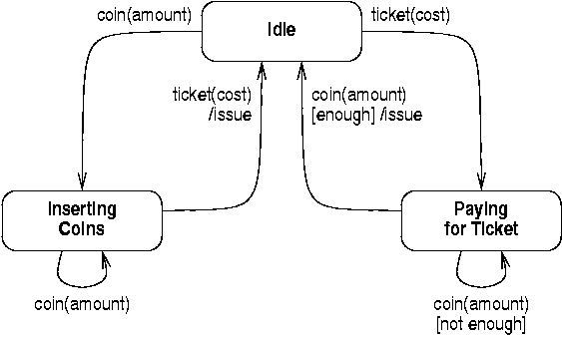
Adding a Second Interaction
If all coins are entered before ticket selected:

Slide 26
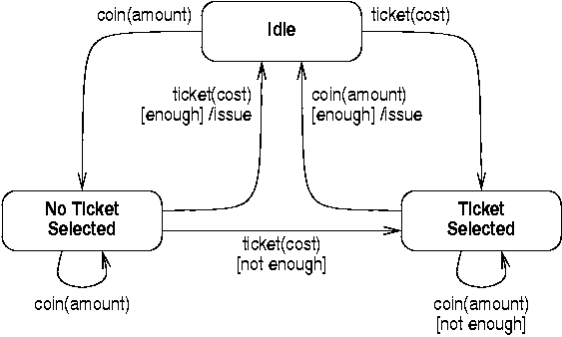
Integrating the Interactions
In fact, events can occur in any sequence:

Slide 27
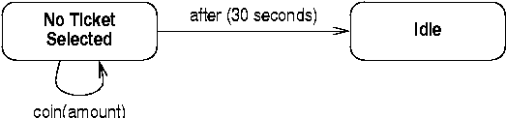
Time Events
Suppose the ticket machine times out after 30 seconds
  we need to fire a transition that is not triggered by a user-generated event
  UML define time events to handle these cases

Slide 28
Activity States
Activity states defines periods of time when the object is carrying out internal processing
  unlike normal activities, these cannot be interrupted by external events
  only completion transitions leading from them
  useful for simplifying the structure of complex statecharts

Slide 29
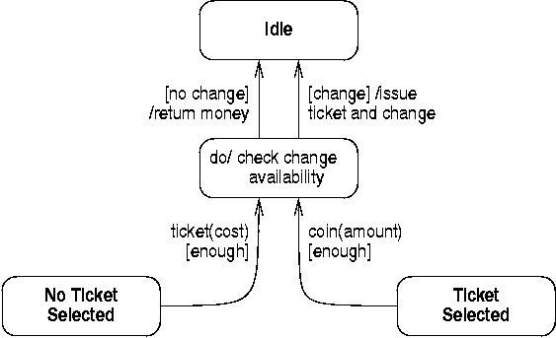
Returning Change
Use an activity state to calculate change

Slide 30
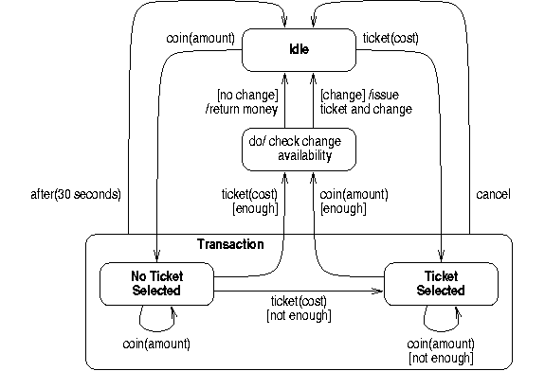
Ticket Machine Statechart

